Slide 1
Seeed Line Finder Summary (ESP32Thing MicroPython)

Slide 2
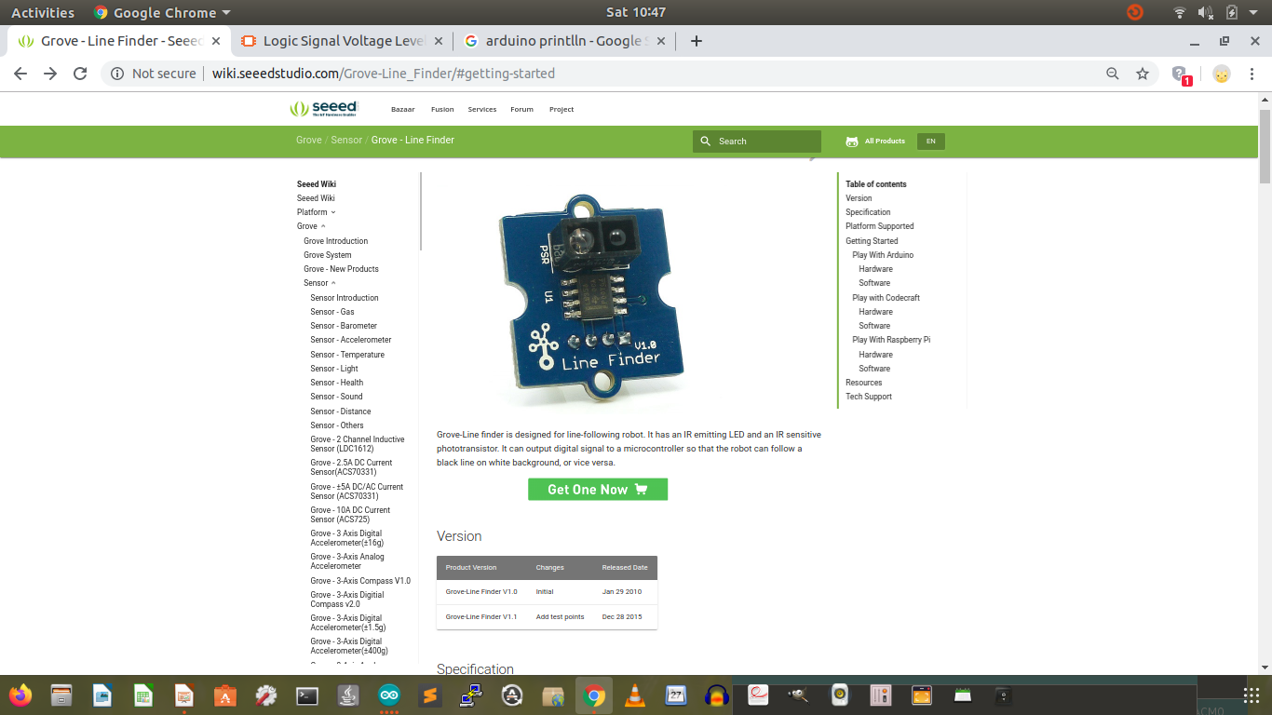
http://wiki.seeedstudio.com/Grove-Line_Finder/#getting-started

Slide 3
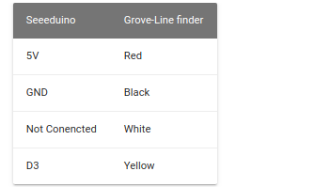
D3 (Input mode for UNO)
D3 = 1 (black surface), 0 (white line)

Slide 4
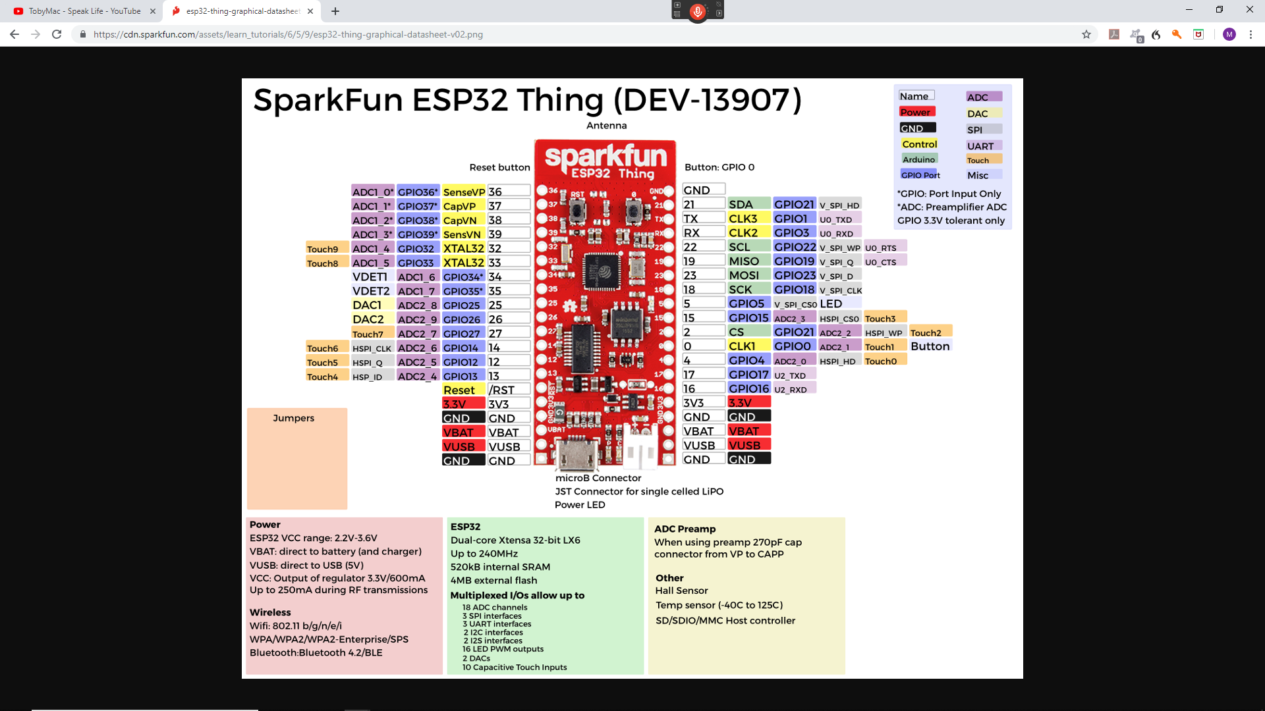
Use GPIO 21 for input

Slide 5
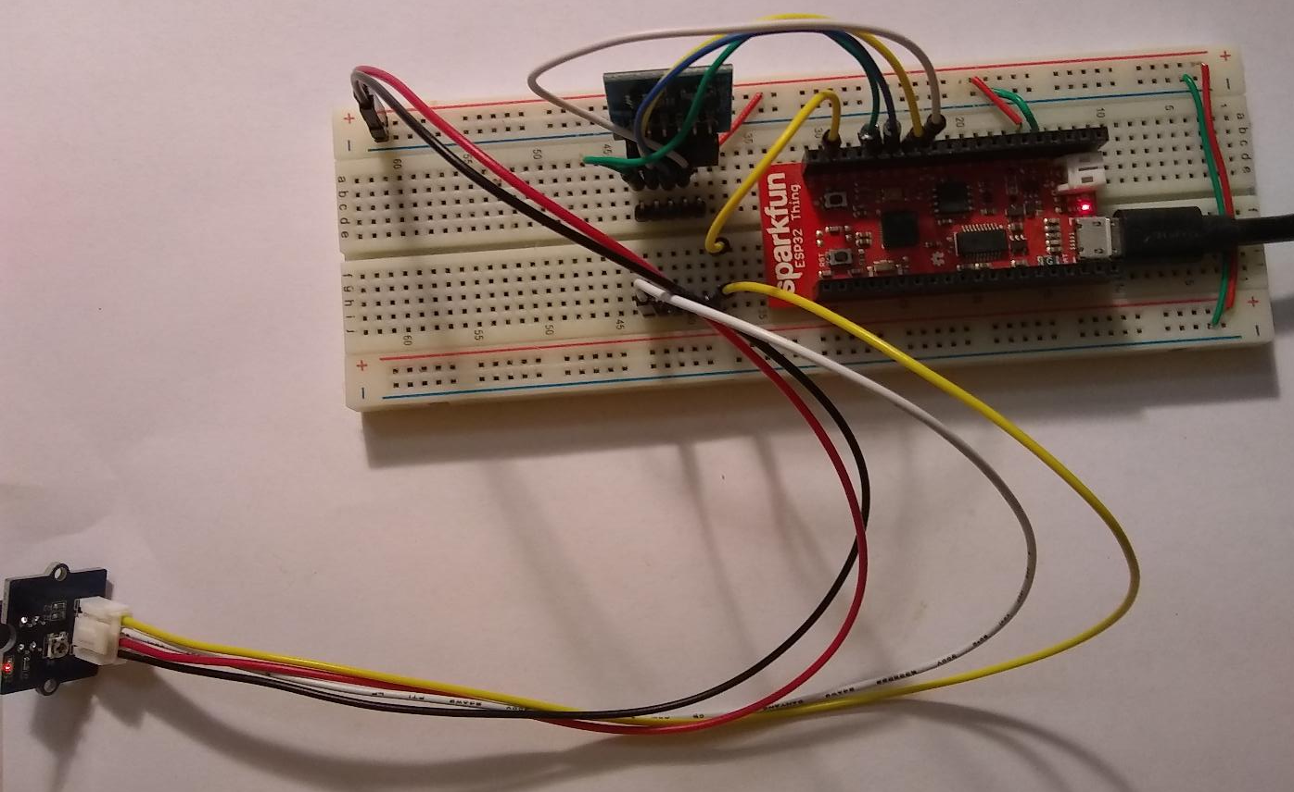
3.3V Red, GND Black, GPIO21 Yellow, NC White

Slide 6
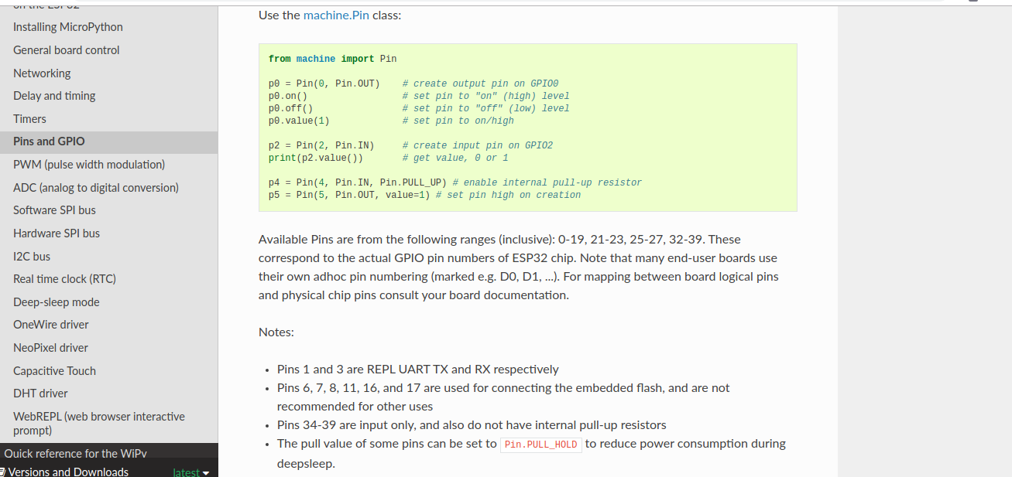
P2 Example

Slide 7
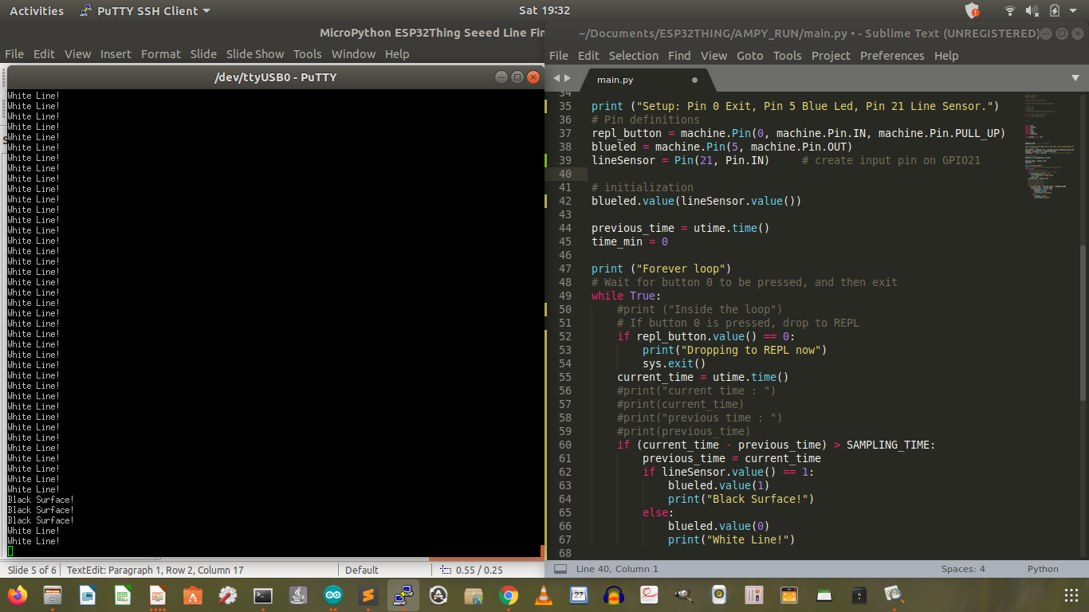
Code and Output (BLUE LED Good)

Slide 9
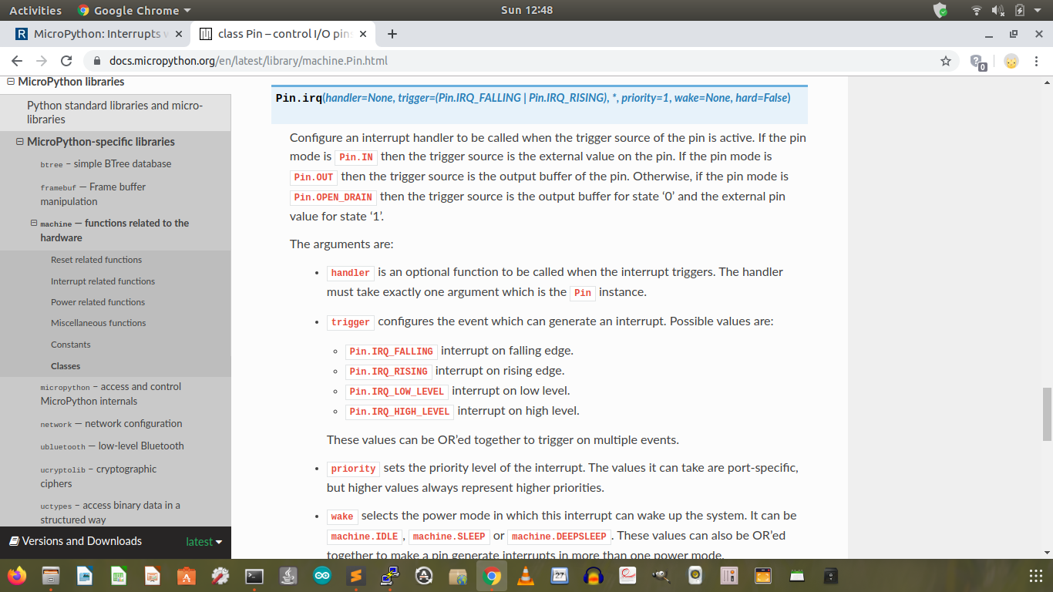
Using ESP32 Interrupt
https://docs.micropython.org/en/latest/library/machine.Pin.html

Slide 10
https://randomnerdtutorials.com/micropython-interrupts-esp32-esp8266/
blueled = machine.Pin(5, machine.Pin.OUT)
def handle_interrupt(pin):
global blueled
if pin.value() == 1:
blueled.value(1)
print("Black Surface!")
else:
blueled.value(0)
print("White Line!")
# Pin for the line finder sensor
pir = Pin(21, Pin.IN) # create input pin on GPIO21
pir.irq(trigger=Pin.IRQ_RISING | Pin.IRQ_FALLING, handler=handle_interrupt)

Slide 11
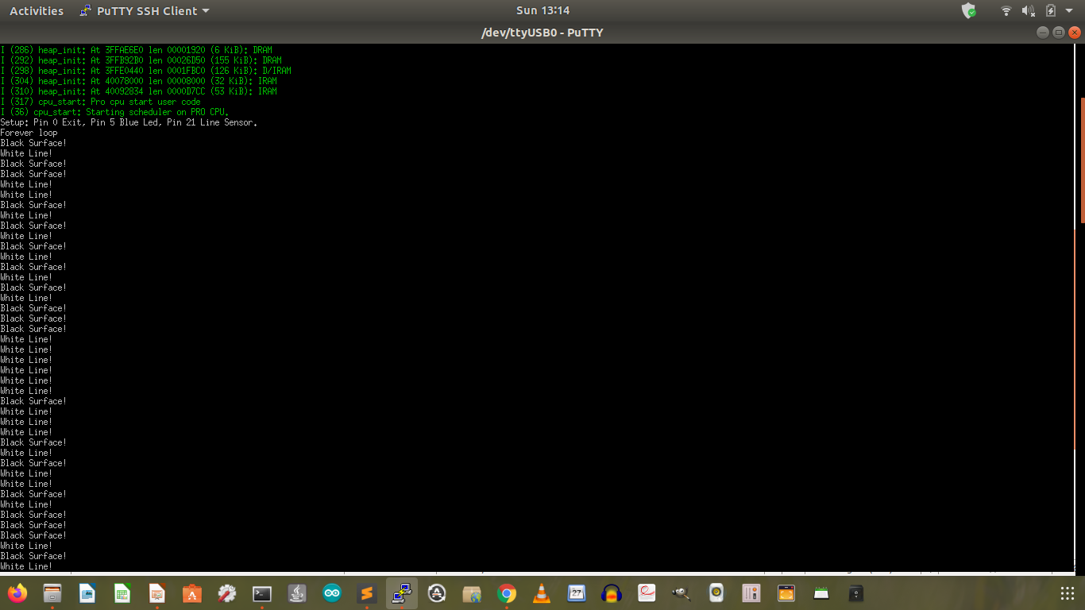
Some glitches. Otherwise, it works well.

